Slide 1

ISHA<>TradeWiser
Empowering farmers and FPOs

Slide 2
Small farmers and FPOs face numerous challenges, such as lack of market access and limited financial resources, but TradeWiser is here to help them overcome these obstacles and succeed in agriculture.

Slide 3

Introduction to TradeWiser
TradeWiser is a digital platform that connects farmers and FPOs directly with buyers and lenders, enabling them to sell their produce and access financing at fair prices.
We provide a range of services, including warehousing, financing, logistics, and trading, all in a single, easy-to-use platform.
By working with TradeWiser, farmers and FPOs can get better prices for their produce, reduce post-harvest losses, and access finance at affordable rates, while buyers get access to high-quality produce at competitive prices.
Our platform is built on cutting-edge technology, including AI/ML, blockchain, and data analytics, which allows us to provide transparent and efficient services to our users.
Our mission is to empower farmers and FPOs by giving them access to the tools, knowledge, and resources they need to succeed in today's market.

Slide 4

Challenges faced by farmers and FPOs
Lack of access to financing: Many farmers and FPOs struggle to get loans and credit at affordable rates.
Limited transparency in trading: Traditional trading systems can be opaque, leading to mistrust and uncertainty among farmers and FPOs.
Inefficient supply chain management: Inadequate infrastructure and logistics can cause delays and losses in the supply chain.
Lack of market information: Farmers and FPOs often have limited information on market trends and pricing, making it difficult to make informed decisions.

Slide 5
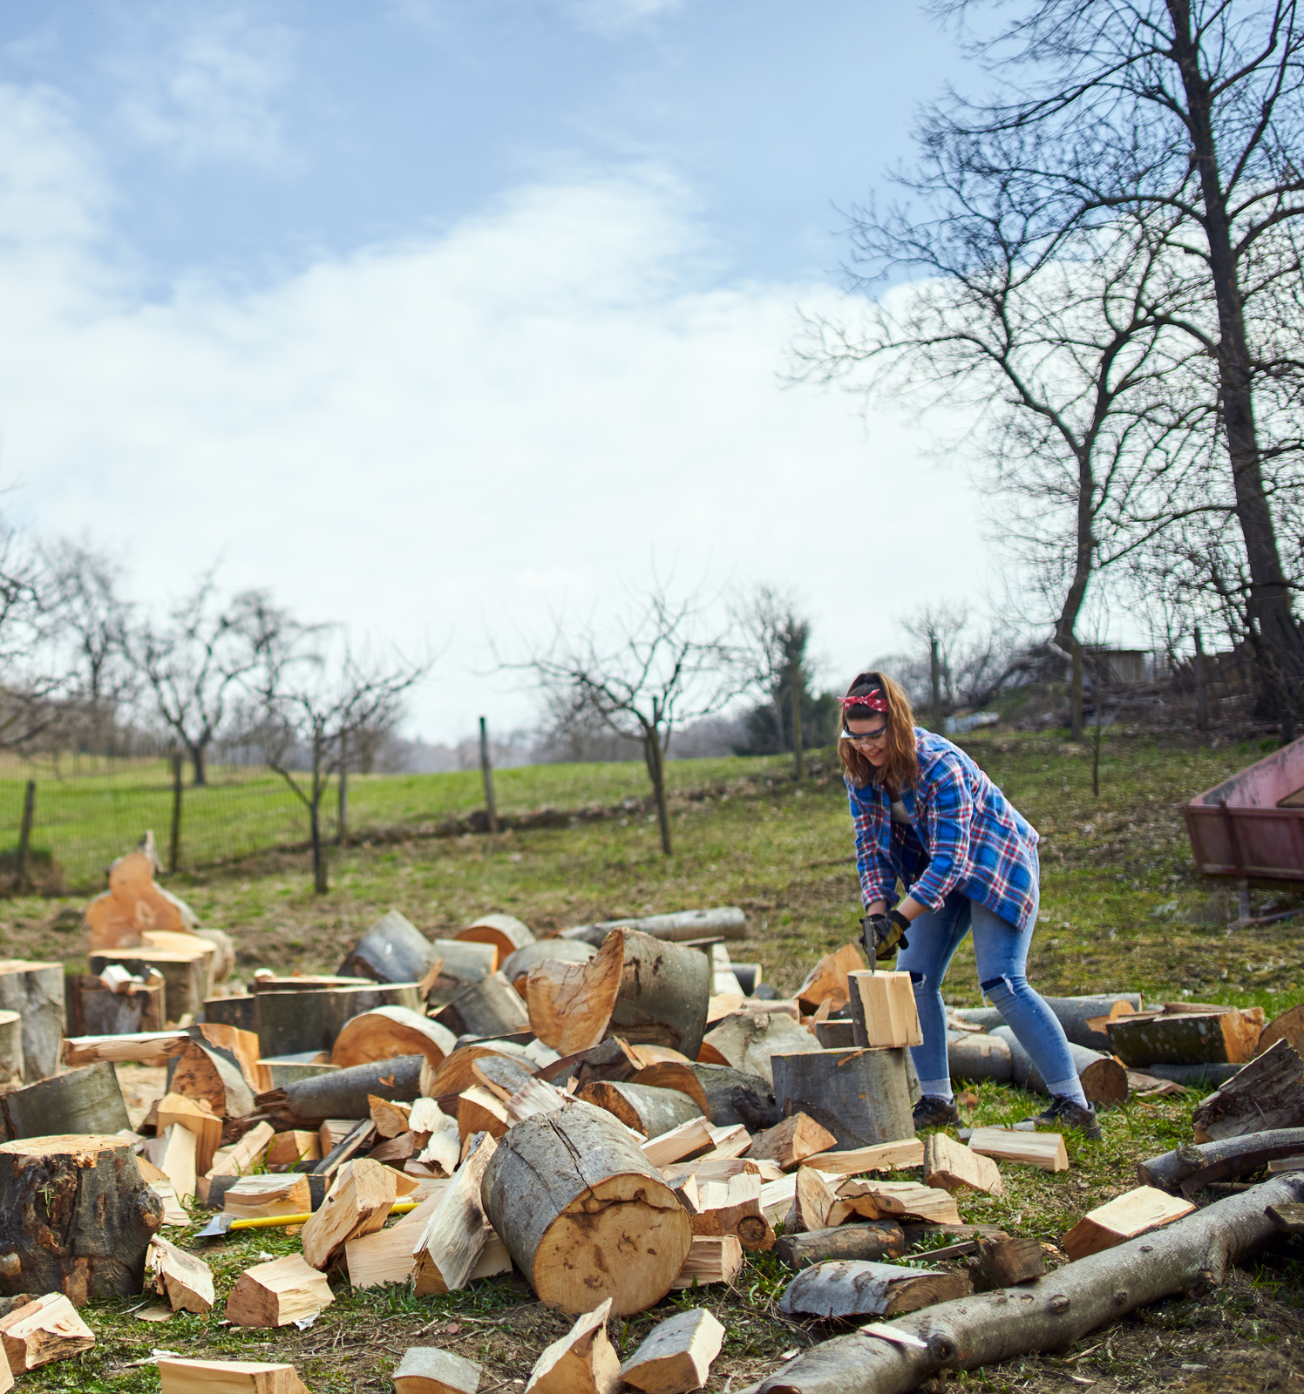
What TradeWiser Offers
Optimized cost of storage: Our warehousing solutions ensure cost optimization and proper storage of commodities
Financing at subsidized rates of interest: We offer financing solutions to farmers and FPOs at low-interest rates to help them grow their business
Low transaction fees for trading: Our transparent and low transaction fees help farmers and FPOs get the best prices for their commodities

Slide 6
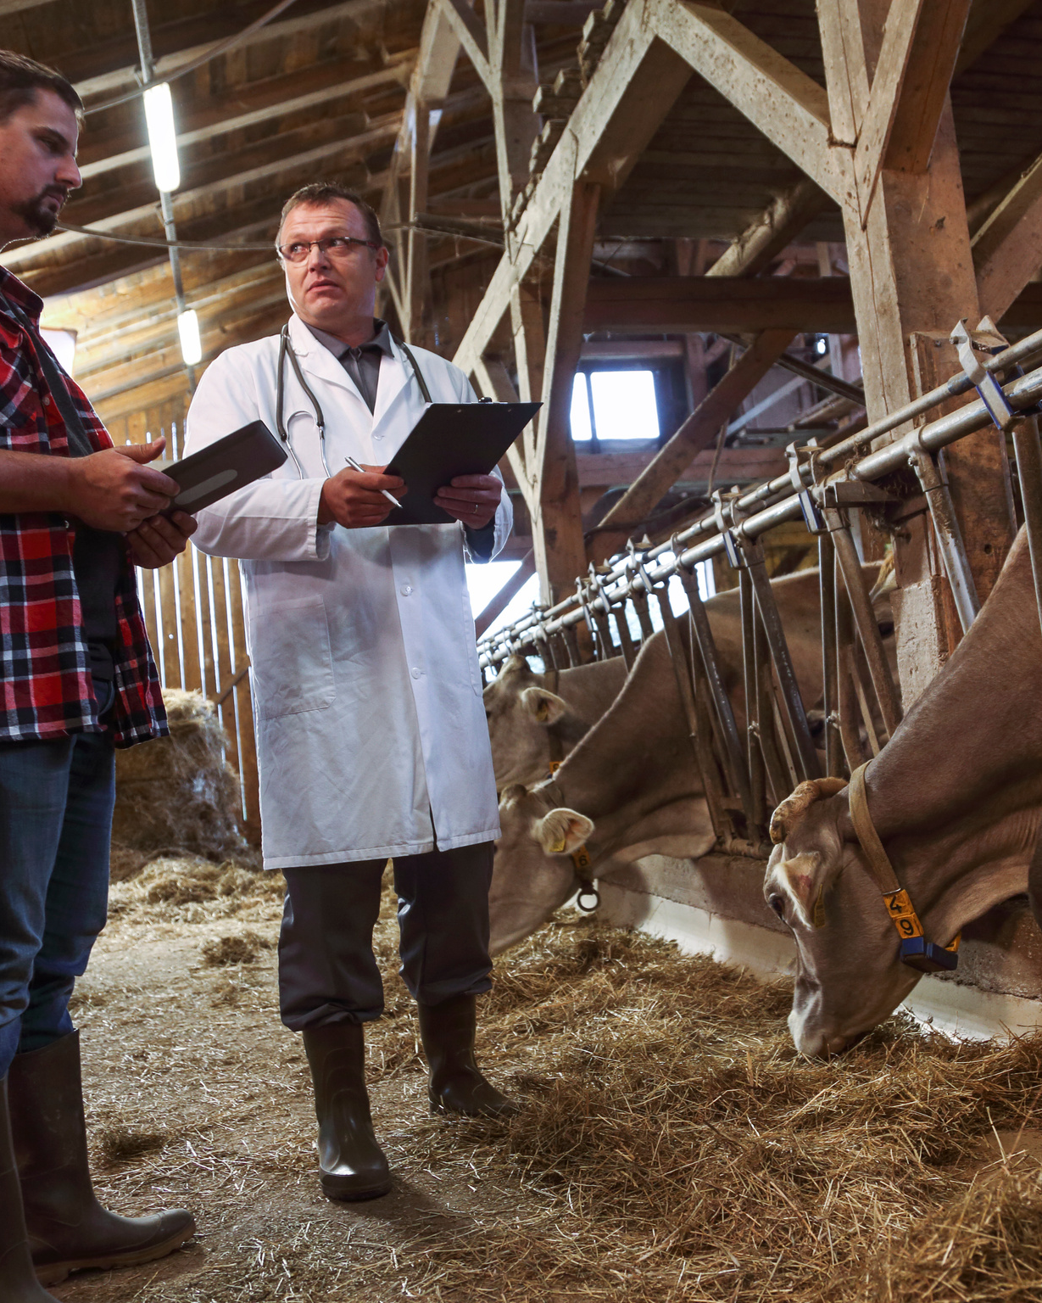
How TradeWiser Works
Provide mRegister with TradeWiser: Farmers and FPOs can register with TradeWiser and create a profile to access our services.
Storage Management: TradeWiser provides optimized storage solutions to farmers and FPOs to reduce their costs and ensure the safety of their produce.
Trading Platform: Our transparent trading platform enables farmers and FPOs to sell their produce directly to buyers, eliminating intermediaries and ensuring fair prices.
Financing: TradeWiser offers financing at subsidized rates of interest to farmers and FPOs, enabling them to access credit and invest in their businesses.
Transaction Processing: Our low transaction fees ensure that farmers and FPOs receive maximum value for their produce and minimize their costs.
Rules-based Mechanism: TradeWiser uses a rules-based mechanism to ensure that all transactions are conducted fairly and transparently, creating a level playing field for all participants.
arket insights and intelligence.
Overcome logistical and infrastructural challenges faced by farmers and FPOs.

Slide 7
Rules-based mechanism
At TradeWiser, we believe in a fair and transparent trading system for all. That's why we have developed a rules-based mechanism that governs all transactions on our platform.
Our system is designed to ensure that every trade is conducted in a consistent and unbiased manner, without any scope for manipulation or unfair practices.
The rules are based on industry best practices and have been developed in consultation with experts and stakeholders in the agriculture sector.
Some of the key features of our rules-based mechanism include price discovery through auction-based trading, standardization of quality parameters, and transparent and low transaction fees.
By using our platform, farmers and FPOs can have complete confidence in the trading process and be assured of fair prices for their products.

Slide 8

Benefits for Farmers and FPOs
Increased income through fairer trading practices
Access to financing at subsidized rates of interest
Optimized cost of storage
Low transaction fees for trading
Transparent and efficient trading platform
Enhanced market visibility and access to a wider network of buyers

Slide 9

Partnership with
Isha Foundation
We invite Isha Foundation to partner with TradeWiser in empowering farmers and FPOs in Tamil Nadu. Together, we can create a transparent and fair ecosystem for trading, and provide access to finance at subsidized rates of interest. Join us in making a positive impact on the lives of farmers and FPOs, and contribute to building a sustainable agricultural economy. Contact us to learn more and take the first steps towards a fruitful partnership.

Slide 10
Implementation Process
Conduct Needs Assessment: Identify the needs of the farmers and FPOs and understand their current practices
Design Customized Solutions if any: Develop customized solutions based on the needs identified
Training and Support: Provide extensive training to farmers and FPOs on how to use the TradeWiser platform and other relevant aspects
Offer ongoing support and troubleshooting to ensure smooth adoption
Piloting and Testing: Conduct a pilot test to ensure the system works efficiently and effectively
Address any feedback or concerns and refine the system as needed
Scale Up and Expansion: Scale up the implementation and expand to more farmers and FPOs

Slide 11
Proposed partnership to bring TradeWiser's services to Isha Foundation's network of farmers
TradeWiser and Isha Foundation share a common goal of supporting farmers and FPOs
How can we work together?
Isha Foundation can introduce TradeWiser to farmers and FPOs on the ground
TradeWiser can provide training and support to Isha Foundation on the platform's use and benefits
Benefits for Farmers and FPOs
Increased income through optimized cost of storage, financing at subsidized rates of interest, and transparent trading fees
Greater transparency in trading through a rules-based mechanism
Benefits for Isha Foundation
Enhanced support for farmers and FPOs through access to TradeWiser's services
Potential for increased trust and partnership with farmers and FPOs
Next Steps
Schedule a meeting to discuss further and explore partnership opportunities
Provide more details on TradeWiser's services and potential benefits for Isha Foundation's network of farmers through a controlled trial on the ground.

Slide 12
Thank you for considering TradeWiser as a partner in your farming journey. We understand the challenges faced by farmers and FPOs, and we are committed to providing innovative solutions.

